Slide 1
CS 5/7330
Graph Databases

Slide 2
Graphs
Graphs
Vertices and edges
Vertices (may) have (multiple) labels/attributes
An edge connects a pair of vertices
Can be directed (or not)
Can have (multiple) labels/attributes
May have multiple edges between any pairs of vertices (not common, but can be useful)
Graphs can be used to model:
Relationships
Maps
Networks

Slide 3
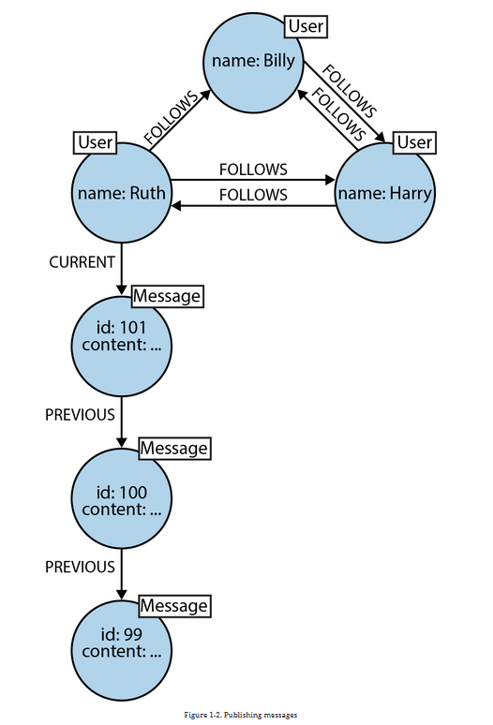
Graphs
Example:
From: Eifrem, Robinson, Webber, “Graph Databases”, 2nd edition

Slide 4
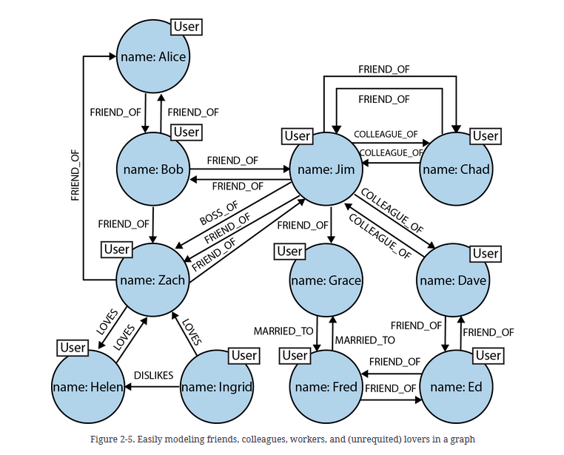
Graphs
Example:
From: Eifrem, Robinson, Webber, “Graph Databases”, 2nd edition

Slide 5
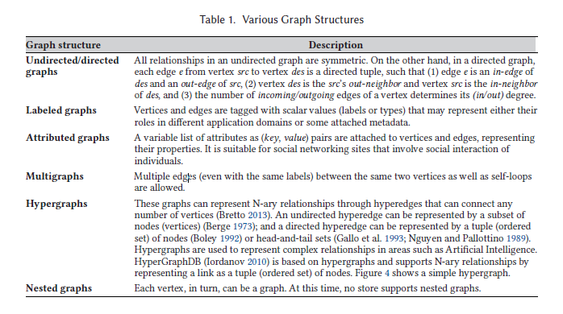
Different types of graphs

Slide 6
Typical Operations for graph databases
On-line graph navigations:
Explore a (typically small) subset of vertices
Require fast response time
Two types
Path query
Whether a path exists between two given vertices
Conditions on the edges along the path
Can also be given only one vertex and find all the other vertices that can be reached/can reach it from the query vertex

Slide 7
Typical Operations for graph databases
On-line graph navigations:
Explore a (typically small) subset of vertices
Require fast response time
Two types
Pattern matching query
Find all subgraphs that is isomorphic to the query subgraph
General graph isomorphism is NP-complete
Tree isomorphism has polynomial time solutions

Slide 8
Typical Operations for graph databases
Off-line analytical graph computation
Analyze large (number of) graphs
Typically iterative computation (not map-reduce)
Require highly tuned graph packages
Aim for high throughput, not low latency

Slide 9
Example : Neo4j
Based on the Labelled Property Graph Model
4 major component of a graph
Nodes – generally for entity
Relationships (edges) – generally for relationship between entities
Properties – key/value pairs that is associated with nodes and/or relationships
Like document model, no need for fixed schema
Labels: Assigned to nodes (notice that, just labels, not key/value pairs)

Slide 10
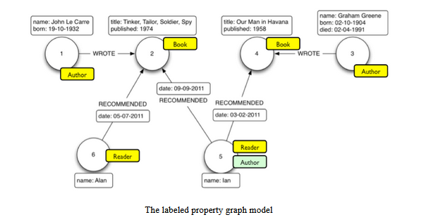
Example : Neo4j
From, Jerome Baton, “Learning Neo4j 3.x”, 2nd edition

Slide 11
Neo4j Data Model
Work best for binary relationship between entities
May need extra node for n-ary relationships
Challenge of whether making something a property or a node
Make graphs simpler vs. query speed
Depends on whether it is faster to traverse a graph vs. search node/edge based on properties

Slide 12
Neo4j Data Model
General mapping from E-R model to Graph Model
Entity -> Nodes (with labels serve as names)
(Binary) Relationship -> Edges
Attributes -> Properties

Slide 13
Cypher
Common database language for graph databases
Based on patterns and pattern matching
Basic ideas:
Database : a set of nodes and edges
Commands to create those nodes and edges
Queries: specifying a pattern of edge/node/paths/subgraphs and try to match it.

Slide 14
Cypher
Creating a node:
CREATE (u: User {username: “greg”, age: “33”})
Return a User (label) node (u) that has a property (name/”greg”, age/33)
The variable u is used as a reference to the node
You can create multiple nodes (separate each node with a comma) in a statement
CREATE (u: User:Admin {username: “greg”, age: “33”})
A node can have multiple labels
This node has two labels, User, Admin.
No notion of sub-labels.

Slide 15
Cypher
Finding a node
MATCH (a:User), (b:System)
WHERE a.username=“greg” AND b.sysname = “UNIX”
RETURN a, b
Notice that if multiple nodes matches they will all be returned (like a Cartesian Product)
Projections
MATCH (a:User {name: “John Doe”})”
RETURN a.age, a.gender

Slide 16
Cypher
Patterns used for queries
(a)
matching any node.
a is the variable name that use to refer to the node in the rest of the query
(a) - - > (b)
Match any pair of nodes that go from a to b
(a) < - - (b)
Match any pair of nodes that go from b to a
(a) - - > (b) - - > (c)
Match three nodes that form a path from a to b to c

Slide 17
Cypher
Patterns used for queries
(a: User)
matching any node with the label user.
a is the variable name that use to refer to the node in the rest of the query
(a: User:Admin)
Matching nodes with BOTH labels
(a:User|Admin)
Matching nodes with either label

Slide 18
Cypher
Patterns used for queries
(a: {name:”John”, age:25)
matching any node with the following properties.
(a) -> [{length : 30}]-> (b)
Matching a path where the edge has the property specified

Slide 19
Cypher
Building an edge
MATCH (a:User), (b:System)
WHERE a.username=“greg” AND b.sysname = “UNIX”
CREATE (a)-[pr:LOGIN]->(b)
SET pr.date =“11/11/2020”
RETURN pr
Create an edge from node a to node be, with the label “LOGIN” and key/value pair (date/”11/11/2020”)

Slide 20
Cypher
Constraints:
Uniqueness Constraint:
CREATE CONSTRAINT ON (a:USER) ASSERT a.username IS UNIQUE
Ensure uniqueness of username for all USER nodes
Property Existence Constraint:
CREATE CONSTRAINT ON (a.User) ASSERT exists(a.username)
Ensure every node of User have username property

